Slide 1
‘Romeo and Juliet’-
Plot Summaries

Slide 2
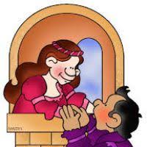
Act One Synopsis: ‘Romeo and Juliet’
In the town of _________, in northern _________, two noble families, The __________ and the __________, have been deadly _________ for centuries. A fresh _________ of their ancient ________ forces Prince __________ to order all _________ to cease on pain of _______. _________, the heir of the Montague household, fools himself that he is in love with the disrespectful __________. To cure him of his sadness, his friend __________ persuades him to attend a _________ ball put on by the Capulets. Romeo, after seeing many other beauties, will think his ‘swan a ______.’ Having smuggled himself into the ball, he is attracted by _________, daughter of the Capulets. She learns the identity of her admirer, and then confesses that her only _______ has sprung from her only ______. Romeo’s presence has been discovered by fiery ________ who wishes to slay him there and then. However, old Capulet _________ him to harm any of the guests, including gate crashers. Tybalt ________ to settle with Romeo at a later date.
Can you find the 20 missing words? Write the synopsis out, underlining the words as well.

Slide 3
Act Three Synopsis: ‘Romeo and Juliet’
In the meantime, _______ has been carrying out his _______ to seek out Romeo for his intrusion at the Capulet ____. He encounters him returning from Lawrence’s cell, having already _______ Juliet. Romeo makes every effort to _______ Tybalt’s hurtful comments, realising that Tybalt is, by marriage, his __________. However, failing to understand his friend’s apparent apathy and inaction, __________ fights on Romeo’s behalf but is _____ in the process. Romeo reacts with ______ and in his uncontrollable state of mind ______ Tybalt. Realising his imprudent action, Romeo seeks _______ in the friar’s cell. On hearing of the killings, the ______ of Verona _______ Romeo. Before this is carried out, Romeo is determined to sleep with his _____. That evening, he climbs up a ________ to Juliet’s _______ to _____ with her and bid her farewell before fleeing to _______. Juliet’s parents seek to alleviate their daughter’s sorrow, which they believe is as a result of _______’s death, by arranging her immediate marriage to _______.
Can you find the 20 missing words? Write the synopsis out, underlining the words as well.

Slide 4
Act Four Synopsis: ‘Romeo and Juliet’
Juliet is now in a state of total __________. She seeks out the advice of the ______, being the person who joined them together secretly. Because he is an accomplished ____________, he gives her a special _______ potion made from a combination of herbs which will for a time cause her to appear _____. Her demise will solve the problem of having to marry Paris and therefore commit the crime of ________. She will then be carried to the family ______ for burial. The plan is, that by the time Juliet _______, Romeo will have had the ___________ to return to Verona and whisk her off to _________, where he has been banished.
Can you find the 10 missing words? Write the synopsis out, underlining the words as well.

Slide 5
Act Five Synopsis: ‘Romeo and Juliet’
Tragically, the friar’s _______ explaining to Romeo the plan concerning Juliet’s swallowing of the sleeping _______ fails to reach Romeo. When he is wrongly informed of Juliet’s death by ___________, he procures a deadly ________ from an ____________ in Mantua. He secretly returns to Verona in order to say his final _________ to his wife, planning to die by her ______.
Unexpectedly, Romeo encounters ________ in the tomb. He has arrived to pay his last respects by strewing her grave with _______. Predictably, there is a _____ and Paris is killed. Directly after this violent action, Romeo, at Juliet’s side, ______ the poison and dies ________. Juliet awakens from her deep sleep and realises Romeo’s terrible _______. She immediately commits _______ using Romeo’s _______. Summoned to the tomb by the disturbed _________, Capulet and Montague ______ hands and the two families are _________ as they listen to the friar’s tale of the unhappy ______ which has befallen the __________ lovers, Romeo and Juliet.
Can you find the 20 missing words? Write the synopsis out, underlining the words as well.

Slide 6
Act Five Synopsis: ‘Romeo and Juliet’
Tragically, the friar’s letter explaining to Romeo the plan concerning Juliet’s swallowing of the sleeping potion fails to reach Romeo. When he is wrongly informed of Juliet’s death by Balthasar, he procures a deadly poison from an apothecary in Mantua. He secretly returns to Verona in order to say his final farewells to his wife, planning to die by her side.
Unexpectedly, Romeo encounters Paris in the tomb. He has arrived to pay his last respects by strewing her grave with flowers. Predictably, there is a fight and Paris is killed. Directly after this violent action, Romeo, at Juliet’s side, gulps the poison and dies instantly. Juliet awakens from her deep sleep and realises Romeo’s terrible error. She immediately commits suicide using Romeo’s dagger. Summoned to the tomb by the disturbed watchmen, Capulet and Montague clasp hands and the two families are reconciled as they listen to the friar’s tale of the unhappy fate which has befallen the star-crossed lovers, Romeo and Juliet.
Did you find the 20 missing words?

Slide 7
‘Romeo and Juliet’-
Social/Historical Background

Slide 8
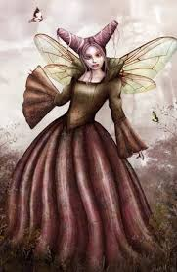
‘Romeo and Juliet’ – Background Context
L.O.
To revise background context to ‘Romeo and Juliet’
Look at the following images. What do they tell you about the background to Shakespeare’s story? IMAGE 14
(14) Queen Mab
Sh introduces folklore in many of his lyrical speeches in his plays. The Queen Mab speech given by Mercutio (Act1, Sc4) is a prime example. Queen Mab is a well-known fairy in Celtic Irish mythology who appeared in literature centuries before Sh. After her appearance in R&J, she became a much loved figure. She is a miniature creature who plays midnight pranks on sleepers. She is described as a ‘mid-wife’ because she gives birth to the dreams of sleeping men!

Slide 9
‘Romeo and Juliet’-
Examples of AQA Lit Exam Questions

Slide 10
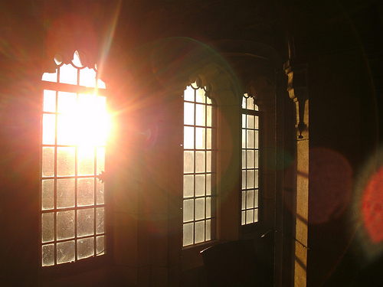
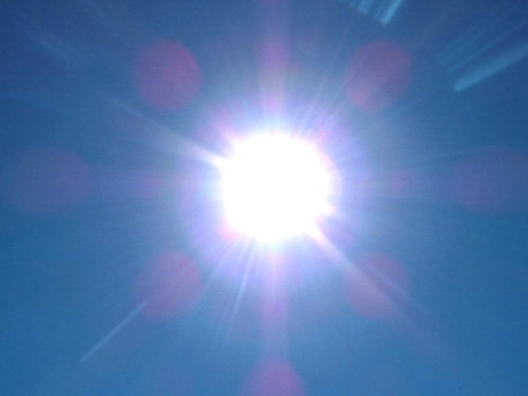

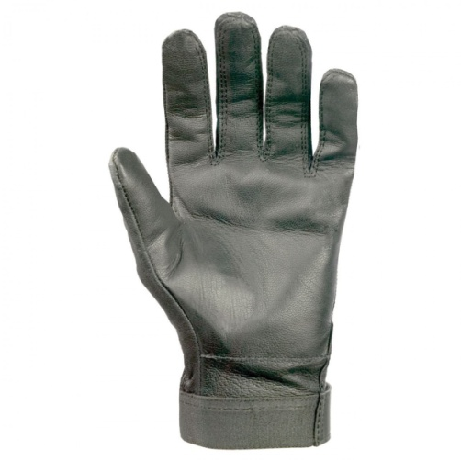


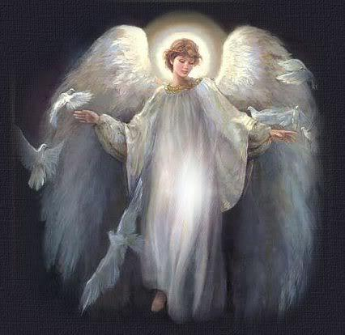
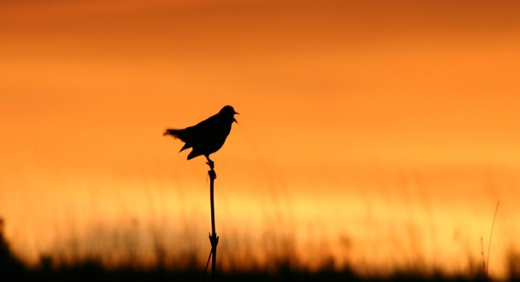

WRITING ABOUT LANGUAGE- ACT 2, SCENE 2
Lines 2-33 (from ‘The Balcony Scene’)
Look at the 9 images below and identify where Romeo makes reference to them in his speech when referring to Juliet (Lines 1-50). Write down quotations.

Slide 11


(1) The Prologue (Lines 1-14)
In a typical tragedy, it is characters from the nobility who suffer fatal misfortune
Two households, both alike in dignity, In fair Verona, where we lay our scene, From ancient grudge break to new mutiny, Where civil blood makes civil hands unclean. From forth the fatal loins of these two foes A pair of star-crossed lovers take their life; Whose misadventured piteous overthrows Do with their death bury their parents' strife. The fearful passage of their death-marked love, And the continuance of their parents' rage, Which, but their children's end, nought could remove, Is now the two hours' traffic of our stage; The which if you with patient ears attend, What here shall miss, our toil shall strive to mend.
The Capulet/Montague feud is long-standing and on-going
Written as a sonnet, ironically attempting to impose order or disorder!
The repetition of ‘civil’ reminds us that all residents of the city are involved
3 phrases reinforce the idea of being in the hands of Fate, see also the compound epithets ‘star-crossed’ and ‘death-marked’
Abstract nouns like ‘strife’ and ‘rage’ compound the sense of drama
Reference to ‘children’ makes it seem more tragic
Social/Historical Context:
Shakespeare uses a device from Greek Drama, the Chorus, which is used to comment on the events occurring in the play
In revealing the ending, the Chorus reinforces the notion of Fate

Slide 12
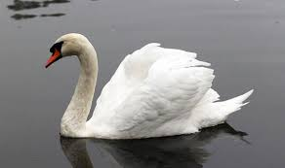
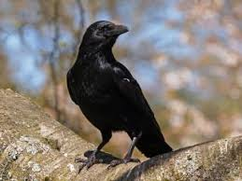
Let’s look at the extract in more detail, looking at the way Benvolio persuades Romeo and the language Shakespeare uses:
Look at the colour-coded, underlined words or phrases spoken by Benvolio.
What do these references tell us about Benvolio’s methods of getting Romeo to go to the Capulet ball?
BENVOLIO
At this same ancient feast of Capulet’s
Sups the fair Rosaline whom thou so loves
With all the admired beauties of Verona.
Go thither, and with unattainted eye
Compare her face with some that I shall show,
And I will make thee think thy swan a crow.
Explain the following words:
ancient:
Sups:
Go thither:
Unattainted:
Social/Historical Context:
What are swans traditionally associated with?
What are crows traditionally associated with?

